Slide 1




Data Analyst Portofolio
SQL QUERY PRACTICE WITH SPOTIFY DATASET
Created By Ni Putu Ayu Sekar Pradnya Dewi

Slide 2

01
Data Overview
Agenda Overview
02
Questions
03
Explanations

Slide 3
Data Overview

Slide 4
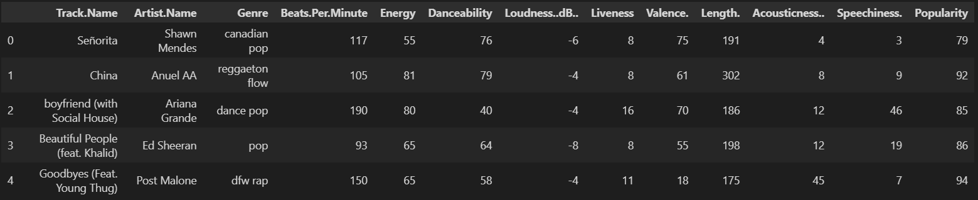
dATA oVERVIEW
The dataset we are using is about Top 50 chart music from spotify, where it has 11 columns and 50 entries.
Source : https://www.kaggle.com/datasets/leonardopena/top50spotify2019

Slide 5
Questions

Slide 6
qUERY QUESTIONS (1)
1
Show all track names where 'Energy' is greater than the average and 'Loudness' is greater than -5 dB. Sort the data by 'Popularity' in descending order.
2
Find the 5 songs with the longest duration, where 'Danceability' is greater than 50 and 'Valence' is greater than 60. Show the 'ArtistName' and 'TrackName' and sort by the longest duration.
3
Count amount of songs where ‘Popularity’ greater than 80 and ‘BeatsPerMinute’ greater than average. Show the result along with average ‘Energy’ of those songs.

Slide 7
qUERY QUESTIONS (2)
4
Find the 'ArtistName' with the highest total number of songs. Show the 'ArtistName' and their total number of songs.
5
Find songs where 'Loudness' is greater than the average, 'Energy' is greater than 60, and the genre is 'pop'. Show the 'ArtistName', 'TrackName', and 'Popularity'.
⁤Show songs where 'Danceability' is greater than 60 and 'Energy' greater than 70. ⁤⁤Include 'ArtistName', 'Genre', and 'Popularity' of each song. ⁤⁤Count the difference between 'Popularity' and the average 'Popularity' from all entries. ⁤⁤Sort the result based on 'Energy' in descending order and include only songs with 'Popularity' higher than the average.
6

Slide 8
qUERY QUESTIONS (3)
7
Find the ‘genre’ with the highest total of songs and sort it based on the total number of songs. Calculate the average of ‘Danceability’ and ‘Energy’ from songs in each genre, but only for genres with more than 10 songs. Show the ‘genre’, total number of songs, average ‘Danceability’, and average ‘Energy’.
8
Show all songs where ‘Valence’ is greater than the average ‘Valence’ of the entire dataset and ‘Liveness’ is less than the average. For each song, include the difference between ‘Popularity’ and the average ‘Popularity’ of those songs. Sort the result based on the difference in descending order.
9
Calculate an average of ‘BeatsPerMinute’ and ‘Popularity’ from songs where ‘Acousticness’ is less than 20 and ‘Speechiness’ is greater than 10, but add another criteria to only calculate artists who have more than one song in the dataset. Show the result, including the number of songs that meet the criteria.

Slide 9
qUERY QUESTIONS (4)
10
Find songs from artists who have the letter ‘b’ in their name, and calculate the average of ‘Popularity’ and ‘Loudness’ from those songs. Calculate the percentage of contribution from the total ‘Popularity’ and total ‘Loudness’ of the songs that meet the criteria compared to the total ‘Popularity’ and ‘Loudness’ of the entire dataset.

Slide 10

Explanations

Slide 11
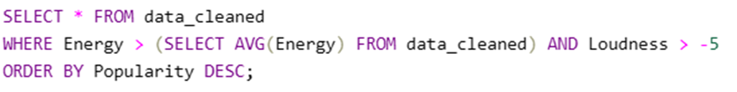
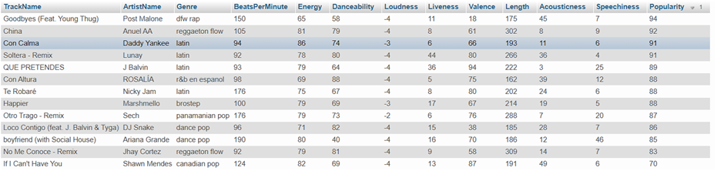
# 1
Show all track names where 'Energy' is greater than the average and 'Loudness' is greater than -5 dB. Sort the data by 'Popularity' in descending order.

Slide 12
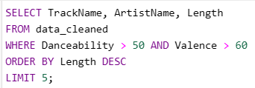
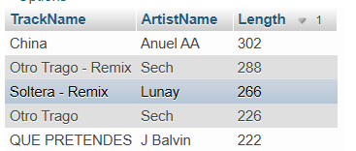
Find the 5 songs with the longest duration, where 'Danceability' is greater than 50 and 'Valence' is greater than 60. Show the 'ArtistName' and 'TrackName' and sort by the longest duration.
# 2

Slide 13


Count amount of songs where ‘Popularity’ greater than 80 and ‘BeatsPerMinute’ greater than average. Show the result along with average ‘Energy’ of those songs.
# 3

Slide 14
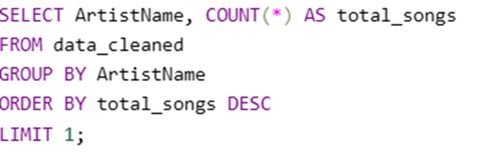

# 4
Find the 'ArtistName' with the highest total number of songs. Show the 'ArtistName' and their total number of songs.

Slide 15
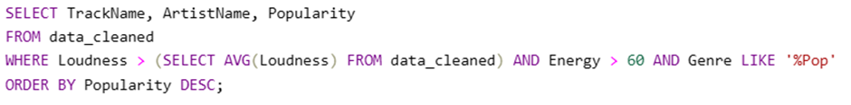
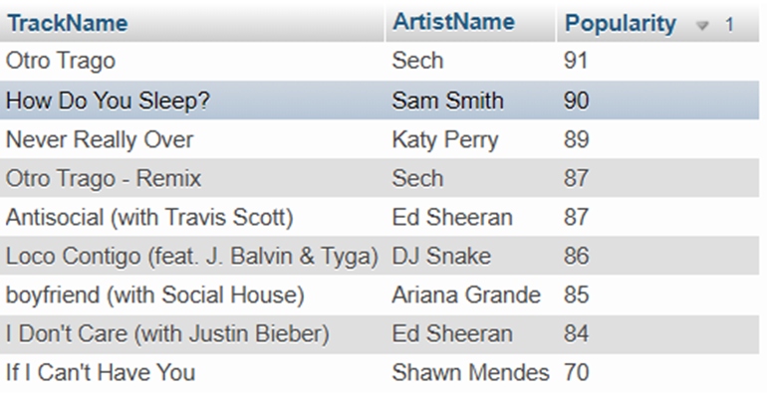
Find songs where 'Loudness' is greater than the average, 'Energy' is greater than 60, and the genre is 'pop'. Show the 'ArtistName', 'TrackName', and 'Popularity'.
# 5

Slide 16
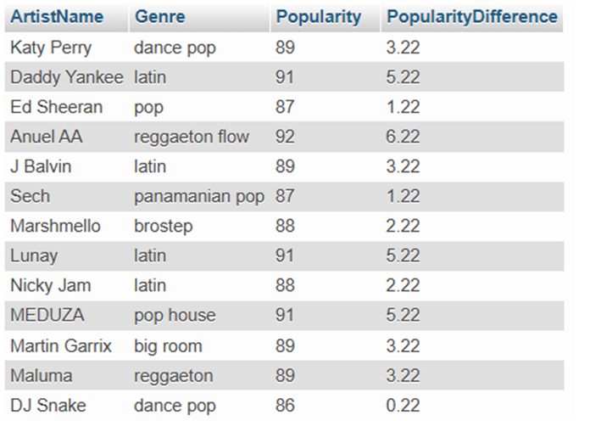
⁤Show songs where 'Danceability' is greater than 60 and 'Energy' greater than 70. ⁤⁤Include 'ArtistName', 'Genre', and 'Popularity' of each song. ⁤⁤Count the difference between 'Popularity' and the average 'Popularity' from all entries. ⁤⁤Sort the result based on 'Energy' in descending order and include only songs with 'Popularity' higher than the average.
# 6

Slide 17
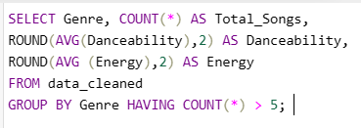

Find the ‘genre’ with the highest total of songs and sort it based on the total number of songs. Calculate the average of ‘Danceability’ and ‘Energy’ from songs in each genre, but only for genres with more than 5 songs. Show the ‘genre’, total number of songs, average ‘Danceability’, and average ‘Energy’.
# 7

Slide 18
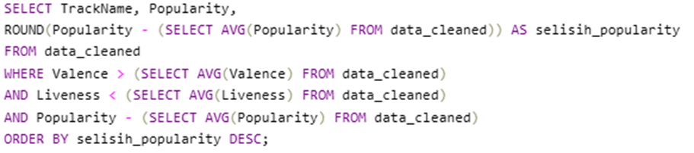
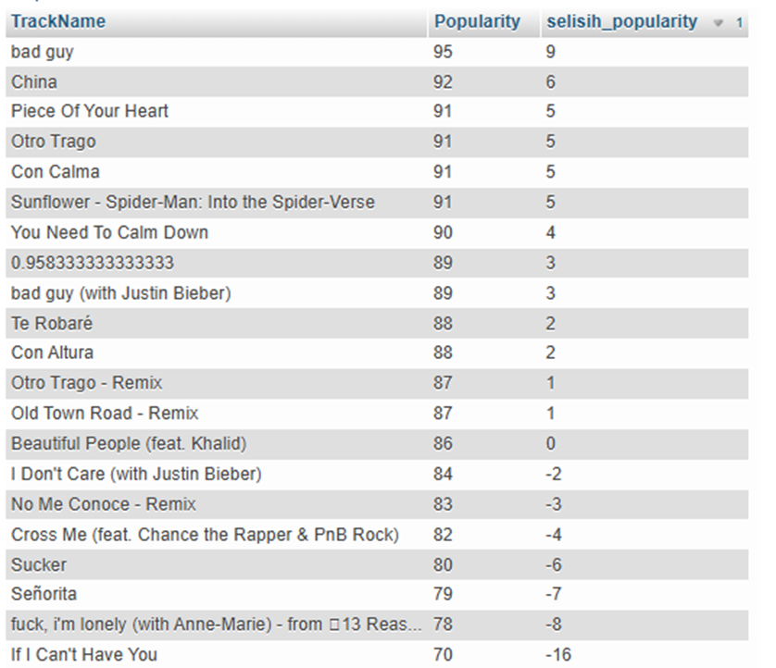
Show all songs where ‘Valence’ is greater than the average ‘Valence’ of the entire dataset and ‘Liveness’ is less than the average. For each song, include the difference between ‘Popularity’ and the average ‘Popularity’ of those songs. Sort the result based on the difference in descending order.
# 8

Slide 19
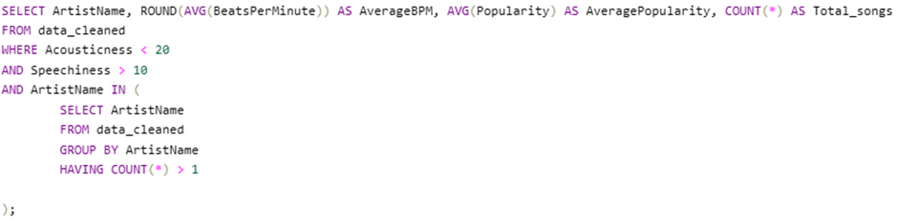

Calculate an average of ‘BeatsPerMinute’ and ‘Popularity’ from songs where ‘Acousticness’ is less than 20 and ‘Speechiness’ is greater than 10, but add another criteria to only calculate artists who have more than one song in the dataset. Show the result, including the number of songs that meet the criteria.
# 9

Slide 20
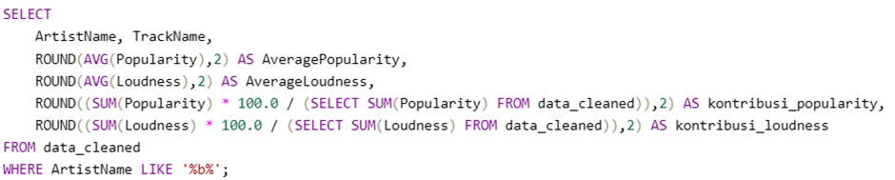
Find songs from artists who have the letter ‘b’ in their name, and calculate the average of ‘Popularity’ and ‘Loudness’ from those songs. Calculate the percentage of contribution from the total ‘Popularity’ and total ‘Loudness’ of the songs that meet the criteria compared to the total ‘Popularity’ and ‘Loudness’ of the entire dataset.
# 10

Slide 21

Thank You
Have a bright and cheerful day!!!!
: Ayusekar1822@gmail.com

